Slide 1
GMM ALGORITHM
CLUSTERING ALORITHMS

Slide 2
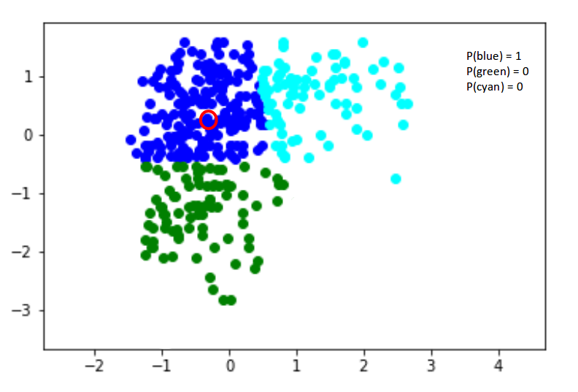
What is GMM?
Definition: A probabilistic model that assumes data points are generated from a mixture of several Gaussian distributions.
Key Features:
Can model complex data distributions.
Each cluster is represented by a Gaussian distribution.
Key Concepts of GMM
Mixture Model: Combination of multiple Gaussian distributions.
Parameters:
Mean (μ\muμ): Center of the Gaussian.
Covariance (Σ\SigmaΣ): Shape of the Gaussian.
Weight (π\piπ): Contribution of each Gaussian to the mixture.

Slide 3
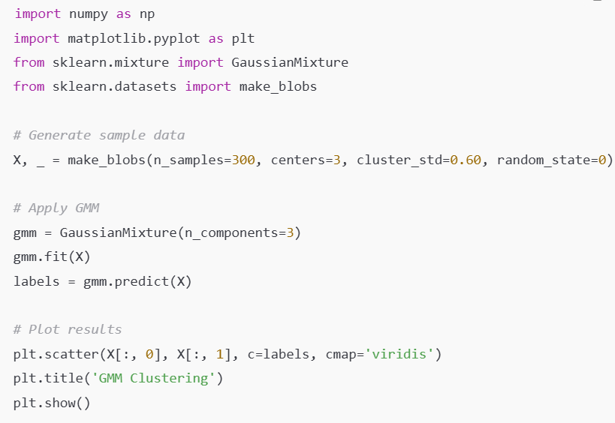
GMM in scikit-learn
Examples:

